Slide 1
Jesus is Risen
Hallelujah

Slide 2
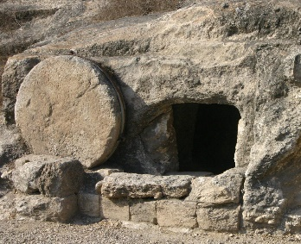

Slide 3
Luke 9 v 22
“The Son of Man must suffer many terrible things,” he said. “He will be rejected by the elders, the leading priests, and the teachers of religious law. He will be killed, but on the third day he will be raised from the dead.”
Luke 18 v 33
They will flog him with a whip and kill him, but on the third day he will rise again.”
Luke 24 v 7
that the Son of Man must be betrayed into the hands of sinful men and be crucified, and that he would rise again on the third day.

Slide 4
Matthew 28 v 11 - 15
¹¹ While they were going, behold, some of the guard went into the city and told the chief priests all that had taken place. ¹² And when they had assembled with the elders and taken counsel, they gave a sufficient sum of money to the soldiers ¹³ and said, “Tell people, ‘His disciples came by night and stole him away while we were asleep.’ ¹⁴ And if this comes to the governor's ears, we will satisfy him and keep you out of trouble.” ¹⁵ So they took the money and did as they were directed. And this story has been spread among the Jews to this day.

Slide 5
Mark 16 v 5 - 7
5 And entering the tomb, they saw a young man sitting on the right side, dressed in a white robe, and they were alarmed. 6 And he said to them, “Do not be alarmed. You seek Jesus of Nazareth, who was crucified. He has risen; he is not here. See the place where they laid him. 7 But go, tell his disciples and Peter that he is going before you to Galilee. There you will see him, just as he told you.”

Slide 6
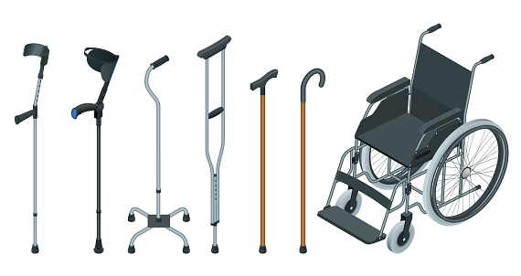

Slide 7
John 21 v 1 - 3
After this Jesus revealed himself again to the disciples by the Sea of Tiberias, and he revealed himself in this way. ² Simon Peter, Thomas (called the Twin), Nathanael of Cana in Galilee, the sons of Zebedee, and two others of his disciples were together. ³ Simon Peter said to them, “I am going fishing.” They said to him, “We will go with you.” They went out and got into the boat, but that night they caught nothing.

Slide 8
Matthew 5 v 13 -16
¹³ “You are the salt of the earth, but if salt has lost its taste, how shall its saltiness be restored? It is no longer good for anything except to be thrown out and trampled under people's feet.
¹⁴ “You are the light of the world. A city set on a hill cannot be hidden. ¹⁵ Nor do people light a lamp and put it under a basket, but on a stand, and it gives light to all in the house. ¹⁶ In the same way, let your light shine before others, so that they may see your good works and give glory to your Father who is in heaven.

